Slide 1
Is There a Yellow Brick Road?
Strategic Planning for Academic Departments
Kyle Mayer
Department Chair,
Management & Organization (Marshall)
April 3, 2025

Slide 2
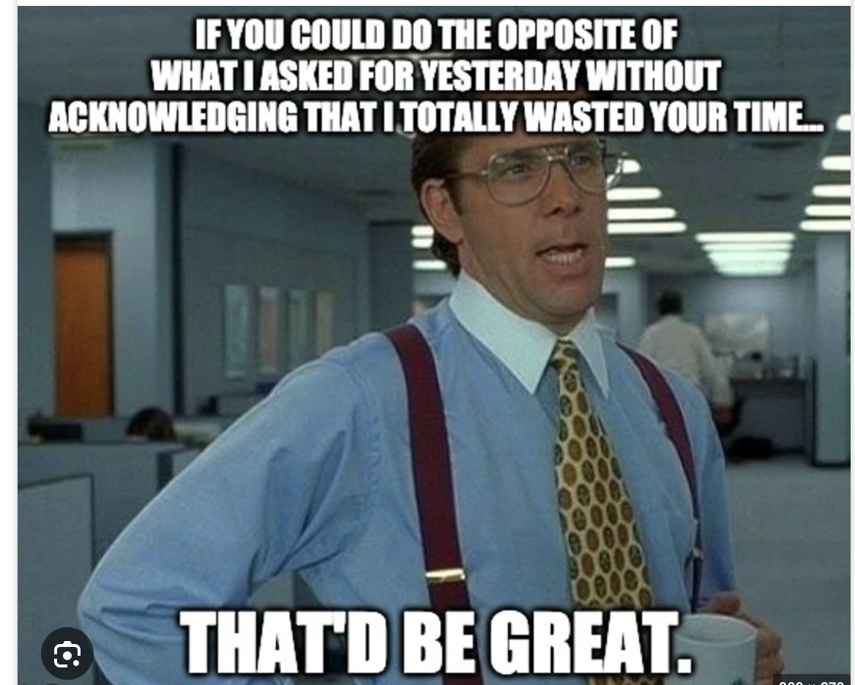
Why Create a Strategic Plan?
How do all members of the department know what to do?
What guides the department actions on hiring? Curriculum? Culture?
How will you improve department performance? What are the aspects of performance that are most important?
Dept Chairs can’t make all decisions, so a clear strategy guides the actions of everyone in the department

Slide 3
Overarching Keys to the Process
Transparency & communication
  Keep everyone involved in why you are doing this, what to do, progress, etc.
Organization
  Keep on top of things, check in with committee leads on progress, etc.
Flexibility
  Listen to feedback and adjust if necessary
Share findings with everyone involved
  Document the results with action plans

Slide 4
One Other Important Factor
Agree up front on what is core to the department that you want to build on
You need to have a general consensus on your strengths as a department and where you need some improvements
  What advantages or strengths do you want to build on? What are the weaknesses?
What are the goals of the department
  You will always have multiple goals across teaching, research, service, but how do you prioritize while make room for each?
  How will you handle tradeoffs?

Slide 5

Need Psychological Safety
But it must also be safe to disagree and debate!!

Slide 6
Engagement and Psychology Safety Matter
You need to get people bought in to doing a strategic plan for the department
Explain the need for it and how it will help address key issues and lead to a clearer plan for the future
Also need to make sure that everyone’s voice will be heard
  People need to be free to speak up or the process will not be effective
  For example, you can’t have senior people intimidating junior people into being quiet

Slide 7
Subcommittee Creation Needs to Account for Psych Safety
If you have issues with psych safety in your department, then create teams to try and minimize these issues
Committee leaders need to be on board with making sure all voices are heard
  There can be a tendency for senior faculty to dominate the process, so take steps to set expectations for junior and clinical faculty to speak up (and for senior tenured faculty to listen to them)

Slide 8
Dept Chair Role in the Process
Leader-initiator
  Set it up and get it started well
Project manager
  Track progress and keep teams on task
Do NOT try to take over and unduly influence any of the groups
  This is hard! Avoid getting too involved or being seen as trying to drive a predetermined outcome
  Guidance is good; control is not (fine line sometimes)
Clearly communicate and document results

Slide 9
Step 1: Who to Involve
First answer: Everyone in the department
  But not everyone through the entire process
Levels of involvement:
  Lead the process: Dept Chair
  Advise on the process: Advisory Committee
    Should be small (2-4 people) to provide feedback and perspective to you as the dept chair.
  Sub-committee chairs
  Sub-committee members

Slide 10
Who to Involve (cont’d)
All department faculty need to be involved in a committee (barring something unusual or sabbaticals)
  TT/T and RTPC
Gray areas:
  PhD students & Staff
    Can involve in certain sub-committees but depends on where their perspective could be useful
    Particularly with staff, don’t ignore them
      Often have valuable feedback on culture at least
  Adjunct faculty
    Consider including long standing adjuncts, but probably not newer ones unfamiliar with the department

Slide 11
Where to Start?
What are the key strategic issues that need to be addressed in the strategic plan?
This question will guide what committees you create and what questions you have them address

Slide 12
My Experience with MOR’s Strategic Planning Process
The advisors helped me assess the right committees to create
Our strategic issues:
  Hiring priorities (e.g., criteria for evaluation)
  Supporting research (especially junior faculty)
  Improving enrollment in electives
  Improving teaching quality
  Assess and improve the culture of the department

Slide 13
Getting Buy In
You need to get everyone on board that this is a good idea
Explain the types of issues that a strategic plan could address
Point to tangible decisions and direction for the department that will emerge from creating a strategic plan
  It can be a chance to discuss some challenging topics that can be hard to bring up in regular department meetings

Slide 14
Need Clear Objectives for Each Committee
Each committee needs to know exactly what questions to address
These clear questions will guide who belongs on each committee
Clear direction also focuses the effort, as some committees have a tendency for scope creep (or may avoid touchy issues)

Slide 15
Committee Objectives Drive Membership
Who to put on each committee?
Need to think about:
  Expertise
  Interest (what people care about
  Personalities!!
    This one is key!
    Can’t ignore “challenging” faculty but have to put them in a situation where they at least can’t derail things
    Also have to consider who gets along with whom (or where the conflicts are) and put faculty who don’t get along on different committees. (Example from MOR)

Slide 16
Committee Membership (cont’d)
Committee leads
  Respect from colleagues is more important than rank
  Need leaders, not just senior faculty
  Must actually run the committee, so need to be good with people and organized
Committee members
  People who care about the topic
  Mix of different areas (e.g., TT, T, and RTPC)
    But focus on those who are relevant—e.g., we didn’t include RTPC on TT/T hiring criteria committee
  People who work well together
    This last one is key!! You need cohesive groups.

Slide 17
Clear Objectives for Each Group
Make deliverables very clear
  What problems to solve or issues to address
  Are they tasked with making decisions, providing recommendations, or merely highlighting key issues?
    I think having them recommend changes and then having the whole department discuss and make decisions is probably the best way to go
  Provide a clear timeline
  Have interim deliverables to check on status
  (The Department Chair has to be the project manager of the whole process)

Slide 18
Timeline
Kickoff
  Include the entire department (everyone involved in the process)
    We even had PhD students there
  Goal is to get some excitement but also provide clear direction and roles
Phase 1
  Committees meet to start to address the key issues within their particular area
  Goal is to come up with preliminary recommendations
  Do any surveys, benchmarking, or other research if needed
  Concludes with presentation of initial recommendations

Slide 19
Timeline (Cont’d)
Phase 2
  Committees address any feedback from the department
  Finalize recommendations and put together action plans
  Concludes with presenting draft of final recommendations to the department
Phase 3
  Bring everything together and finalize what will change and document everything into a strategic plan for the department

Slide 20
Kicking off the MOR Strategic Planning Process
An Example

Slide 21
MOR Strategic Planning Kick-off
USC is a great university, and Marshall is doing very well
  Lots of new faculty; donations are up with Geoff in charge
MOR is doing well
  Enrollments in UG and grad classes are strong (not perfect, but strong)
  Strong publishing
  In leadership positions in the Dean’s office
Great faculty and staff and PhD students! (many of whom are pretty new)
But how do we stay strong and continue to improve?
  That is the focus of our plans for this year

Slide 22
Start Today
Get into four groups and discuss three questions
  What are MOR’s main strengths that we can build on to improve ourselves?
  What are MOR’s main weaknesses that could hold us back?
  What do we want MOR to look like in 5-7 years?
I will collect the notes from each group and share with the department
  We can discuss them briefly today if we have time
Here is the broader plan for our strategic review

Slide 23
Organization of Review:
Research, Teaching and Culture
Research: How do we improve the research environment in MOR?
  Two sub-committees
    Research environment & identity (co-chaired by Nan and Scott)
      How can we better support junior faculty in research?
      How can we better support Associate Professors in getting promoted to Full?
      How can we better assess recruiting priorities and identify key research areas?
      Can/should we do anything to encourage more practitioner-oriented research by tenured faculty?
    PhD Committee (co-chaired by Florenta and Eric)
      How can we improve the MOR PhD program?
        Recruiting? Required classes? Mentoring? And ultimately placement?

Slide 24
Organization of Review:
Research, Teaching and Culture II
Teaching: How do we improve teaching and enrollments in MOR?
  Two sub-committees
    Enhancing Teaching Quality (chaired by Marco)
      How can we better support our faculty as teachers?
      How to provide additional rewards/recognition and coaching where needed?
      How to identify faculty who may need coaching (before the Dean’s office gets involved)?
      How can we encourage faculty to seek feedback and support and encourage innovation?
    Examining MOR Electives (co-chaired by Arvind and Nate)
      How can we improve MOR electives?
      Examine portfolio of electives and suggest changes.
      How can MOR best prepare for the changes coming to include more condensed and online electives for the revised PM and OMBA programs?

Slide 25
Organization of Review:
Research, Teaching and Culture III
Culture: How do we improve the culture in MOR?
(While our culture may be strong, it could be better and even good things need review and adjustment over time.)
  Two culture sub-committees (one chaired by Becky, the other by Christian)
    Conduct a joint culture survey of MOR
    The two sub-committees will then evaluate the results separately and come up with their own recommendations and action plans for MOR
  Our culture is critical. How do we handle conflict? Are all voices heard? We need to make sure we have a super strong culture that supports all faculty and ensures an inclusive and supportive environment for all faculty, staff and students.

Slide 26
Timing and Process
Sept 6 – Kick off the process!! I will send a copy of the old strategic plan to everyone, which includes our vision and values
Sept 7 – October 31
  Each sub-committee will meet (as many times as needed—should be several times) to come up with a preliminary report (rough draft) to share at the fall retreat.
November 1 Fall Retreat
  Each sub-committee will lead a discussion of the entire department on their ideas and get feedback as we discuss them.
November 2 – March 6
  Each sub-committee will determine how best to incorporate the feedback from the department and draft a preliminary final proposal with recommendations
March 7 Spring Retreat
  We will discuss the entirety of the plan going forward and any possible changes, plus we will discuss how to implement it. If there are lingering issues, we can address them in follow up meetings as needed
May 2 MOR End of Year Meeting. Present the finalized plan to the department

Slide 27
Groups for Strategic Review
Research
  Nan*
  Scott*
  Nandini*
  Florenta*
  Eric*
  Shon*
  Joe*
  John*
  Melody*
  Andrea*
  Zack*
  Daphne*
Teaching
  Marco
  Peter C.*
  Nik
  Christine
  Peter K*
  Cheryl*
  Dan*
  Chris
  Marina
  Arvind*
  Nate*
  Christine
  Jody
Culture
  Leigh
  Peer*
  Becky
  Sarah*
  Paul*
  Courtney
  Agi
  Tom*
  Christian
  Gordon
* Denotes TT Faculty
All faculty on the research committees are T/TT
Both clinical and T/TT faculty are involved in the teaching committees, but mostly clinical
Both clinical and T/TT faculty are involved in the culture committee

Slide 28
Sub-Committees for Strategic Review
Research Support
  Nan*
  Scott*
  Nandini
  Shon
  Andrea
  Joe
PhD Program
  Florenta*
  Eric*
  John
  Melody
  Zack
  Daphne
Teaching Quality
  Marco*
  Peter C.
  Nik
  Christine
  Dan
  Cheryl
  Chris
Electives
  Arvind*
  Nate*
  Peter K
  Carl
  Marina
  Jody
Culture Team
  Becky*
  Christian*
  Sarah
  Paul
  Gordon
  Courtney
  Tom
  Peer
  Leigh
  Agi

Slide 29
Conclusion
Strategic planning isn’t an easy process, but it can be worth it
The process requires organization and leadership
  People will get distracted and neglect this process if you don’t keep them on task with regular check-ins and deliverables
Make sure gain consensus at the beginning, communicate well, and wrap it up with clear deliverables and descriptions of what will change
  Plus document the strategic plan for the department so that you can refer back to it

